Slide 1


Green Pace
Security Policy Presentation
Developer: Ryan Laird
Notes:
My name is Ryan Laird and this is my presentation on the Security Policy for Green Pace

Slide 2

OVERVIEW: DEFENSE IN DEPTH
A security policy is essential to establish guidelines and procedures for protecting an organization's assets and implementing defense-in-depth best practices.
Notes:
A security policy is a critical component of any organization's security strategy. It establishes guidelines and procedures for protecting an organization's assets, including data, hardware, software, and facilities. By providing a framework for implementing defense-in-depth best practices, a security policy helps to ensure that multiple layers of security controls are in place, including administrative, technical, and physical measures, to minimize the risk of cyber attacks. In short, a security policy is essential to maintaining the confidentiality, integrity, and availability of an organization's assets and to reducing the risk of security breaches.

Slide 3
THREATS MATRIX
Likely Threats that Have a high likelihood of occurring | Priority Highly relevant standards
Low priority Less relevant standards | Unlikely Threats with a low likelihood of occuring
Not all standards are equal in their risk. This matrix is intended to provide a method to categorize the standards based on their occurrence rate and overall priority.
Notes:
Not all security standards are created equal in terms of their risk. Some standards are more critical to an organization's security posture than others, based on their occurrence rate and overall priority. To prioritize security standards effectively, it's essential to categorize them based on these factors. This matrix provides a useful method for categorizing security standards and prioritizing them accordingly. By using this approach, organizations can focus their resources and efforts on the most critical security standards and ensure that they are adequately addressed to mitigate the risk of security breaches.

Slide 4
10 PRINCIPLES
1. Validate Input Data
2. Heed Compiler Warnings
3. Architect and Design for Security Policies
4. Keep It Simple
5. Default Deny
6. Adhere to the Principle of Least Privilege
7. Sanitize Data Sent to Other Systems
8. Practice Defense in Depth
9. Use Effective Quality Assurance Techniques
10. Adopt a Secure Coding Standard
Notes:
Secure coding is critical to ensuring the security of software applications. By following a set of best practices, developers can reduce the risk of security vulnerabilities and minimize the potential impact of security breaches. This list of ten best practices represents some of the most important guidelines for secure coding. From validating input data and heeding compiler warnings to adopting a secure coding standard and practicing defense in depth, these best practices cover a range of key areas that developers should consider when designing and coding software. By incorporating these practices into their development processes, developers can build more secure and resilient software applications that are better equipped to withstand potential security threats.

Slide 5
CODING STANDARDS
1. Include the appropriate type information in function declarators
2. Do not begin integer constants with 0 when specifying a decimal value
3. Guarantee that storage for strings has sufficient space for character data and the null terminator
4. Do not store an already-owned pointer value in an unrelated smart pointer
5. Do not access freed memory
6. Use a static assertion to test the value of a constant expression
7. Handle all exceptions
8. Do not cast to an out-of-range enumeration value
9. Close files when they are no longer needed
10. Detect and handle memory allocation errors
Notes:
Coding standards are a set of rules and guidelines that developers should follow to ensure that their code is secure, efficient, and maintainable. This list of ten coding standards provides examples of specific guidelines that developers should follow when writing code. From including appropriate type information in function declarators and guaranteeing sufficient space for string storage to handling all exceptions and detecting memory allocation errors, these standards cover a range of key areas that developers should consider when writing code. By following these standards, developers can reduce the risk of security vulnerabilities and ensure that their code is more secure and resilient.

Slide 6
ENCRYPTION POLICIES
Encryption in rest - Encryption in rest ensures that the data is encrypted while resting on the disk. This ensures that if an attacker obtains the hard drive, the data stored will not be immediately accessible without encryption keys.
Encryption at flight - Encryption at flight ensures that data is encrypted while being transmitted. This ensures that if in anyway the data is compromised through transit, it is not immediately compromised.
Encryption in use - Accessing data in use can lead to accessing both encrypted data at rest and data in motion. For instance, if someone can access random access memory, they may find the encryption key for data at rest and decrypt it.
Notes:
Encryption in rest ensures that data is encrypted while resting on the disk, which prevents immediate access to data stored on the hard drive by an attacker without encryption keys. Encryption at flight ensures that data is encrypted while being transmitted, preventing immediate compromise if the data is somehow intercepted. Encryption in use involves accessing data that is in motion and at rest, and policies related to this pillar must be established to ensure that encryption keys for data at rest cannot be accessed by attackers who can access random access memory.

Slide 7
TRIPLE-A POLICIES
Authentication - This pillar involves verifying the identity of a user or entity attempting to access a system or resource. Policies related to authentication may specify requirements for strong passwords, multi-factor authentication, or biometric authentication.
Authorization - This pillar deals with determining what level of access or permissions a user or entity has once they have been authenticated. Authorization policies may define access controls, permissions, or roles that grant different levels of access to different users.
Accounting - This pillar involves tracking and logging all activity on a system or resource, which is useful for auditing, monitoring, and detecting security incidents. Accounting policies may specify requirements for logging, monitoring, or reporting of security-related events.
Notes:
The triple-A policies are a set of security measures that involve authentication, authorization, and accounting. Authentication verifies the identity of users or entities attempting to access a system or resource, authorization determines their level of access or permissions, and accounting tracks and logs all activity on a system or resource, providing auditing, monitoring, and detection of security incidents.

Slide 8
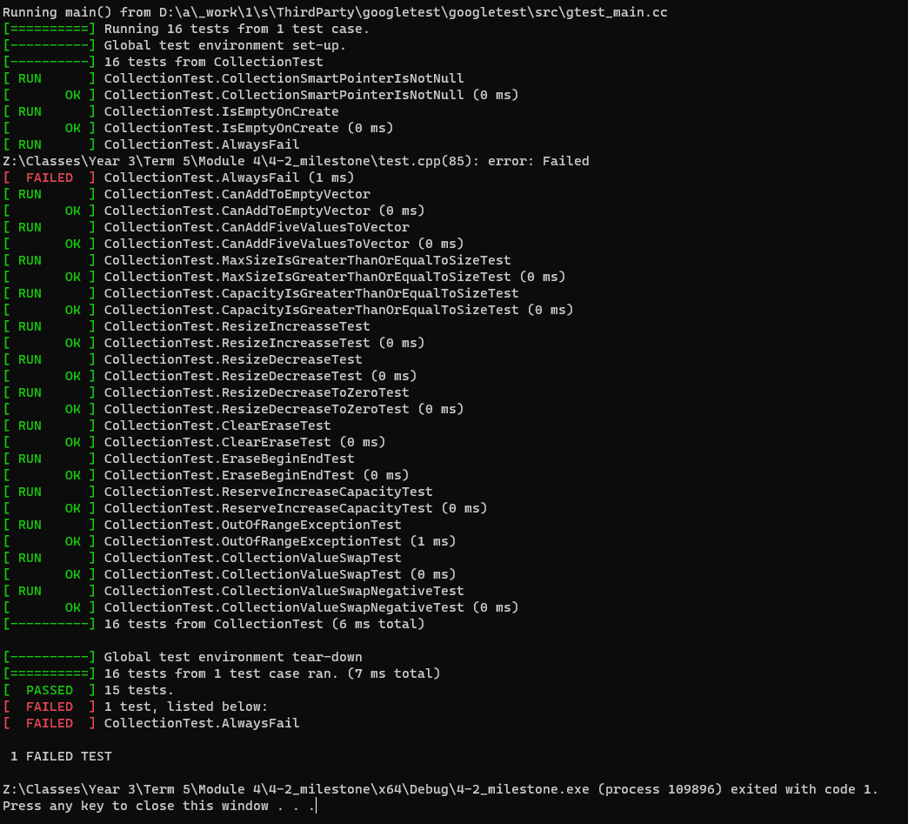
Unit Testing
Unit tests can be used to test various portions of code for unexpected interactions. The unit tests shown are an extensive series of tests on interactions within a vector.
Notes:
Unit testing can be used to test various portions of code for unexpected interactions, and the extensive series of tests shown on the slide demonstrate how interactions within a vector can be thoroughly tested.

Slide 9

AUTOMATION SUMMARY
Notes:
The DevSecOps pipeline is a comprehensive approach to integrating security into every stage of the software development lifecycle, including planning, coding, building, testing, deployment, and monitoring. External security tools are used at various stages to enhance the security of the software, such as vulnerability scanners, code analysis tools, container security tools, and runtime security tools. These tools help identify and fix security flaws in the code during the coding stage, and detect and mitigate security issues in the production environment during deployment and monitoring.

Slide 10
TOOLS
The DevSecOps pipeline integrates security into every stage of the software development lifecycle.
The pipeline includes planning, coding, building, testing, deployment, and monitoring stages.
External security tools are used at various stages to enhance the security of the software.
Examples of external security tools used include vulnerability scanners, code analysis tools, container security tools, and runtime security tools.
Vulnerability scanners and code analysis tools are used during the coding stage to identify and fix security flaws in the code.
Container security tools and runtime security tools are used during the deployment and monitoring stages to detect and mitigate security issues in the production environment.
The use of external security tools in the DevSecOps pipeline helps to improve the security posture of the software and reduce the risk of security breaches.
Notes:
The use of external security tools in the DevSecOps pipeline helps to improve the security posture of the software and reduce the risk of security breaches. Vulnerability scanners and code analysis tools are used during the coding stage to identify and fix security flaws in the code, while container security tools and runtime security tools are used during the deployment and monitoring stages to detect and mitigate security issues in the production environment.

Slide 11
RISKS AND BENEFITS
Problems:
The current strategy is lacking in effectiveness and not delivering the desired results.
There are various risks associated with the current strategy, including security breaches, financial losses, and reputational damage.
Solutions:
Evaluate the current strategy and identify its weaknesses and areas for improvement.
Develop a new strategy that addresses the identified weaknesses and incorporates best practices and industry standards.
Implement the new strategy in a phased approach, starting with the most critical areas and expanding gradually to cover all aspects.
Risks or Benefits:
The benefits of acting now include improving the effectiveness of the strategy, reducing risks, and improving the organization's overall security posture.
The risks of waiting include continued exposure to vulnerabilities and potential security breaches, financial losses, and reputational damage.
Lacking Strategy:
The current strategy is lacking in effectiveness and not delivering the desired results.
Risks of Using this Strategy:
The risks of using the current strategy include security breaches, financial losses, and reputational damage.
Steps to be taken:
Evaluate the current strategy and identify its weaknesses and areas for improvement.
Develop a new strategy that addresses the identified weaknesses and incorporates best practices and industry standards.
Implement the new strategy in a phased approach, starting with the most critical areas and expanding gradually to cover all aspects.
Notes:
The risks associated with a lacking strategy include security breaches, financial losses, and reputational damage. To address these risks, the current strategy must be evaluated to identify its weaknesses and areas for improvement. A new strategy that incorporates best practices and industry standards can then be developed and implemented in a phased approach to reduce risks and improve the organization's overall security posture.

Slide 12
RECOMMENDATIONS
Maintaining the security policy throughout development is critical.
Technology can change and keeping up with this change will keep the policy relevant into the future.
Without a security policy, the odds of a security based issue dramatically increase.
Notes:
Maintaining a security policy throughout development is critical, as technology changes can quickly make an outdated policy irrelevant. Without a security policy, the odds of a security-based issue dramatically increase.

Slide 13
CONCLUSIONS
In conclusion, it is crucial to implement a need-to-have policy towards data, meaning nothing should have access to data that it doesn’t immediately have a need for. In addition, Following the outlined security guidelines is crucial to maintaining proper security throughout development.
Notes:
In conclusion, it is crucial to implement a need-to-have policy towards data, meaning nothing should have access to data that it doesn’t immediately have a need for. Following the outlined security guidelines is also crucial to maintaining proper security throughout development

Slide 14
REFERENCES
Schiela, R. (2020, May 29). SEI CERT C++ Coding Standard - SEI CERT C++ Coding Standard - Confluence. Carnegie Mellon University. https://wiki.sei.cmu.edu/confluence/pages/viewpage.action?pageId=88046682

